Slide 1

Autonomous Vehicle: Application of Low, Mid, and High Level Computer Vision for Road Navigation
ITA-0513-Computer Vision
Presented by
Guided by
Jayalakshmi.C(192524052)
Keethana.G(192521446)
Midhuna.A(192521302)
Varshini.R(192521235)
Haniya afsheena (192572050)
Dr.P.Lourde Mahimai Doss

Slide 2
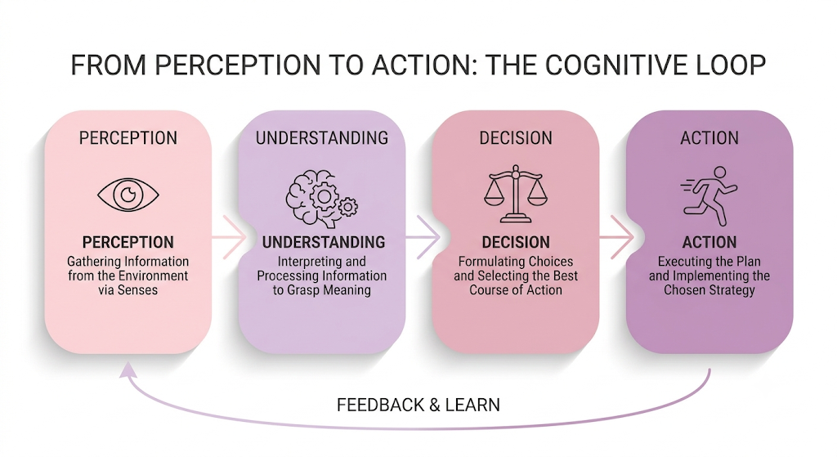
Autonomous Vehicle & Visual Perception
What Enables a Vehicle to “See”?
An autonomous vehicle must continuously perceive its environment before making a driving decision.
Primary visual inputs:
Road and lane markings
Vehicles and pedestrians
Traffic signals and signs
Road boundaries and obstacles
Environmental conditions
Computer Vision Role:
Transforms camera-captured visual data into structured information for autonomous decision-making.

Slide 3
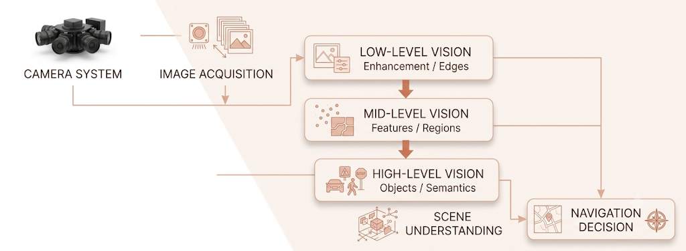
Computer Vision Architecture :
End-to-End Visual Perception Pipeline
Core Transformation
Pixels → Features → Objects → Scene → Decision

Slide 4
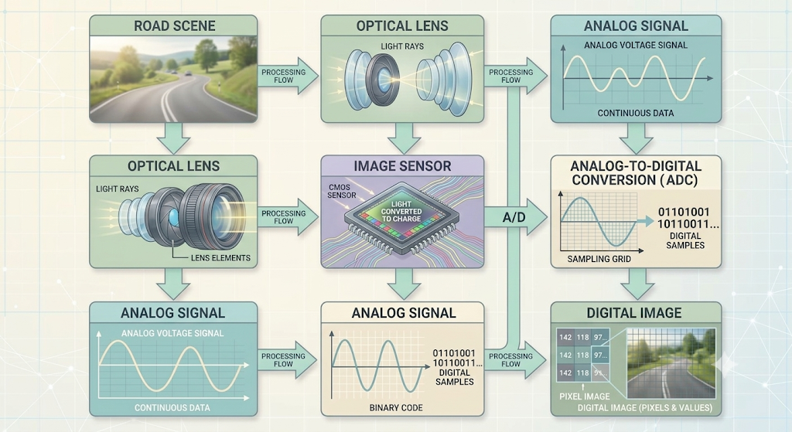
Image Acquisition & Camera Input :
Stage 1: Capturing the Driving Environment
The camera system converts the physical environment into digital image frames.
Acquisition process:
Important Parameters
Resolution
Frame rate
Field of view
Exposure
Dynamic range
Image format
Example:
A forward-facing camera continuously captures road frames at a suitable frame rate for real-time perception.

Slide 5
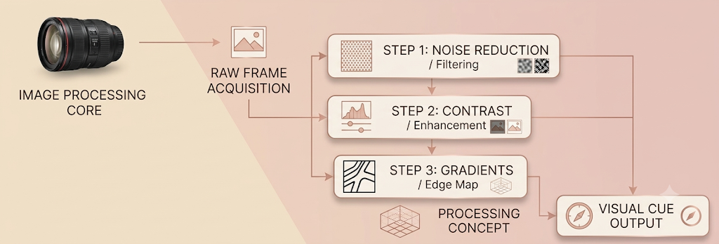
Low-Level Image Processing :
Stage 2: Low-Level Image Processing
Low-level vision operates directly on pixel-level information.
Major Operations
1. Noise Reduction
Removes unwanted variations from captured images.
2. Image Enhancement
Improves brightness and contrast.
3. Filtering
Smooths or sharpens image structures.
4. Edge Detection
Identifies boundaries and structural changes.
Output
A cleaner image containing important visual structures for subsequent analysis.

Slide 6
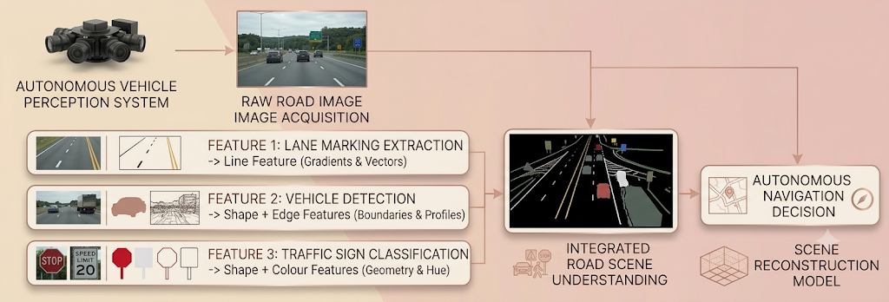
Feature Extraction :
From Pixels to Visual Features
After preprocessing, significant image features are extracted.
Features Used
Edges
Lines
Corners
Shapes
Textures
Colour information
Geometric patterns
Purpose
Reduce complex visual information into discriminative features that can be processed efficiently.

Slide 7
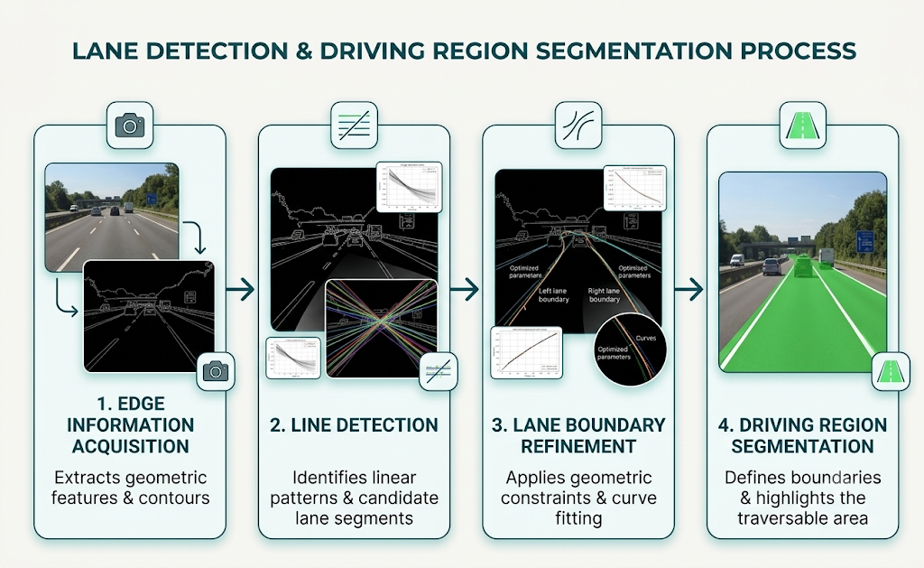
Mid-Level Vision :
Stage 3: Structural Interpretation
Mid-level vision transforms extracted features into meaningful regions, structures, and spatial relationships.
Major Operations:
Image segmentation
Region extraction
Lane detection
Object localization
Shape analysis
Feature matching

Slide 8
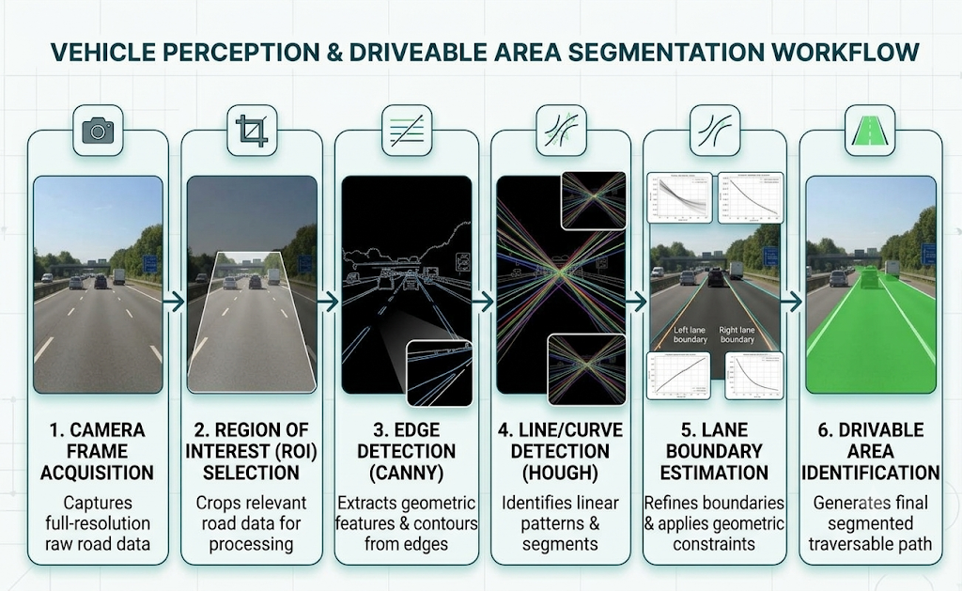
Lane & Road Detection :
Understanding the Drivable Area
Lane detection is essential for determining the vehicle's position relative to the road.
System Output
Current lane
Lane boundaries
Road direction
Possible lane departure
Application
Supports lane keeping and path planning.

Slide 9
High-Level Vision :
Stage 4: Semantic Understanding
High-level Computer Vision interprets visual information in terms of objects and their meaning.
Major Tasks :
Task | Output
Object Detection | Location of objects
Classification | Object category
Recognition | Object identity/type
Semantic Segmentation | Pixel-level scene labels
Traffic Sign Recognition | Sign meaning
Example
The system converts:
Pixel region → “Car”
Pixel region → “Pedestrian”
Pixel region → “Traffic Signal”

Slide 10
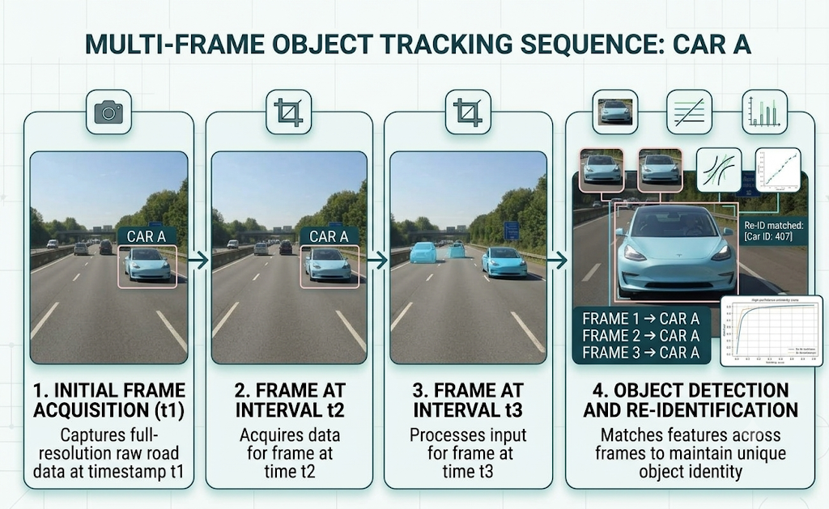
Object Detection & Tracking :
Dynamic Object Perception
Autonomous vehicles must understand not only what objects exist, but also how they move.
Detection
Identifies objects in each frame.
Input → Image
Output → Bounding Boxes + Class Labels
Tracking
Associates detected objects across consecutive frames.

Slide 11
Scene Understanding :
From Individual Objects to a Complete Scene
The vehicle combines information from multiple Computer Vision modules.
Example Road Scene
Detected elements:
🛣️ Lane boundaries
🚗 Vehicle ahead
🚶 Pedestrian
🚦 Traffic signal
🚧 Road obstacle
Scene Interpretation
Vehicle ahead is occupying the current lane, while a pedestrian is approaching the crossing area.
This represents a transition from object recognition to contextual understanding.

Slide 12
Navigation Decision :
From Perception to Driving Action
Visual information is used to support navigation and control.
Decision Pipeline
Object Detection
+
Lane Detection
+
Traffic Signal Recognition
+
Scene Understanding
↓
Navigation Decision
↓
Vehicle Control
Possible Actions
Maintain speed
Brake
Accelerate
Maintain lane
Change lane
Stop
Avoid obstacle
Example
Pedestrian detected in vehicle path
→ Risk assessment
→ Reduce speed
→ Maintain safe distance

Slide 13
Case Study: Autonomous Vehicle at a Traffic Signal :
The camera captures the road scene.
Low-level vision removes noise and detects edges.
Mid-level vision identifies lanes and the road area.
High-level vision detects cars, pedestrians, and traffic signals.
The system understands the traffic situation.
Red signal + pedestrian ahead → Vehicle stops safely.
Final Result: Camera Image → Vision Processing → Scene Understanding → Safe Action.

Slide 14
Conclusion :
Computer Vision enables autonomous vehicles to understand their surroundings using camera images.
Low-level vision improves images and extracts basic features.
Mid-level vision identifies important structures such as lanes and road regions.
High-level vision detects and recognizes vehicles, pedestrians, and traffic signs.
These stages convert raw images into meaningful information.
The information helps the vehicle make safe and intelligent navigation decisions.
Thus, Computer Vision plays a key role in autonomous driving and road safety.

Slide 15
References
Rafael C. Gonzalez, Richard E. Woods, Digital Image Processing, 4th Edition, Pearson, 2018.
Richard Szeliski, Computer Vision: Algorithms and Applications, 2nd Edition, Springer, 2022. Springer
David A. Forsyth, Jean Ponce, Computer Vision: A Modern Approach, 2nd Edition, Pearson, 2012. VisionBook
Milan Sonka, Vaclav Hlavac, Roger Boyle, Image Processing, Analysis, and Machine Vision, 4th Edition, Cengage Learning, 2015. Talis Bristol
E. R. Davies, Computer and Machine Vision: Theory, Algorithms and Practicalities, 4th Edition, Academic Press, 2012. Talis Bristol
Simon J. D. Prince, Computer Vision: Models, Learning, and Inference, Cambridge University Press, 2012. VisionBook
Mark Nixon, Alberto S. Aguado, Feature Extraction and Image Processing for Computer Vision, 3rd Edition, Academic Press, 2012. Vaagdevi College of Engineering

